Slide 1
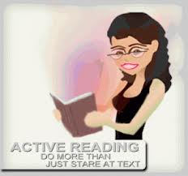
ACTIVE READING
Workshop by:
Kristina Yegoryan

Slide 2
Historical Overview of Reading
EXPRESSIVE REALISM:
1st movement that proscribed importance to reading
Literary texts were interpreted referring to the historical era and real time
The author’s intent was crucial
RUSSIAN FORMALISTS
Advocated literariness: the form of the text was different from the context
Reading was a separate object of study
NEW CRITICS
Very similar ideology as Russian Formalists
Rejected the consideration of historical, cultural context, and of the writer’s intent
The comprehension and the meaning of the text was based on the readers’ interpretation

Slide 3
Reading as Decoding
The next stage of the historical evolution of reading was marked by the traditional overview that regarded reading to be decoding.
Reading became the epitome of literacy
Fast and fluent reading and responses to text related comprehension activities.
Reading was considered a separate from writing.

Slide 4
NEW Rhetoric: Critical Reading
Writing in those days meant “an ability to figure out what the teacher wanted in order to create an “acceptable product” (Clark 4) and reading well meant speed and vocabulary comprehension.
The birth of “Process Movement” in 1963 brought in a renewal of interest in rhetoric and composition theory, a revival that generated the “process” approach to understanding how people write and how they learn to write (Clark 5).
The new rhetoric brought in a new concept of critical
reading that referred to the complex interaction
between the writer, the reader, and the context.

Slide 5
CRITICAL READING
How to help students understand the “use-value” of critical reading?
“Many of our students are ‘good’ readers in the traditional sense: they have large vocabularies, read quickly, and are able to do well at comprehension tasks involving recall of content” (Haas, Flower 124).
The speed in reading, excellence in context recalling doesn’t help all the good
readers does good analysis.
“Yet, these same students often frustrate us, as they paraphrase rather than analyze, summarize rather that criticize texts”
(Haas, Flower 125).
The ability to comprehend the text through decoding or quick reading practices doesn’t develop the ability to think critically nor does it help to engaged with the text and connect it with writing

Slide 6
CRITICAL READING= ACTIVE READING
ACTIVE READING IS A COMMUNICATION between the author and the reader
The readers should actively participate in this communication and not be passive acceptors of the author’s ideas
Should agree or disagree with the author
Should think critically, question, and bring in their own perception of the topic

Slide 7
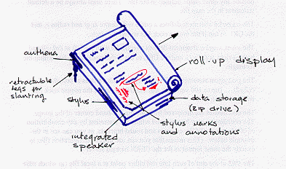
STRATEGIES OF ACTIVE READING 3 PASS APPROACH
The First Pass: Preview the text before Reading
consider the title, the publication date, the author, the images, quotes,
and the length of the text. Make predictions, ask questions to yourself
The Second Pass: Read the text and read for meaning
Read with pencil in hand, make notes in the margins, develop your own system of
annotation, make connections between the text and your life
The Third Approach: Read with Critical Attitude
Consider the author’s argument and intent
Distinguish facts from opinions
Write an evaluation/analysis of the text giving your opinion about the text

Slide 8
Preview and Annotation

Slide 9
3 MOVES of Revision/Invention Through Engagement with a Text
Joseph Harris’s 3 moves that the writers should use to respond to the works of others:
Coming to Terms : Translating
Understand the writer’s arguments, ideas, and strategies
Find the keyword passages and “flashpoints,” used evidence/ examples
Translate them into their own writing/ response
Forwarding
Taking words, ideas from the text and putting them in use in new contexts
Citing a text, paraphrasing, relating the text to personal examples,
Countering
Looking at the text to suggest a different way of thinking
Thinking critically, disagreeing, suggesting a different point of view/ argument
Supporting the new formulated argument/thesis in the response

Slide 10
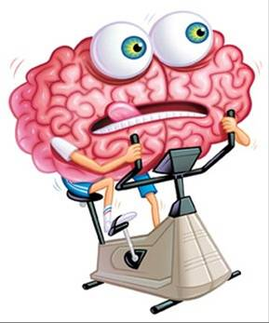
ACTIVITY TIME!
Thank you for your attention!
Let’s practice some ACTIVE READING!

