Slide 1
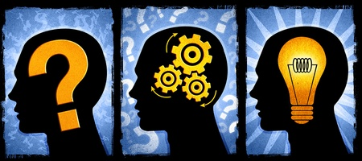
CRITICAL THINKING by K.Yegoryan

Slide 2
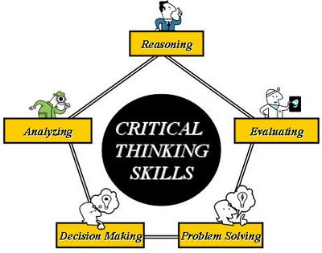
What is Critical Thinking ?
Critical Thinking is a process of reasoning, analyzing,
evaluating, decision making, and problem solving.
Critical thinking is the ability to think clearly and rationally.
It includes the ability to engage in reflective and independent thinking
A CRITICAL THINKER:
Has a sense of curiosity
Asks Questions
Assess (judges) arguments
Is interested in finding new solutions
Listens carefully to others and gives feedback
Examines problems, assumptions, opinions
Is able to reject information that is irrelevant
Can see beyond what is available

Slide 3
THE ORIGINE Of CRITICAL THINKING
The roots go back to the teaching practice and vision of Socrates 2,500 years ago
Socrates:
demonstrated that persons may have power and high position and yet be
deeply confused and irrational
established the importance of asking deep questions that probe profoundly
into thinking before we accept ideas as worthy of belief
established the importance of seeking evidence, examining and reasoning
the assumptions
highlighted the need in thinking for clarity and logical consistency
His method of questioning is known as "Socratic Questioning”
and is the best known critical thinking teaching strategy.

Slide 4
THE Tradition of Critical Thinking
In the Middle Ages
was embodied in the writings and teachings of
Thomas Aquinas (Sumna Theologica) --_always systematically stated,
_answered his critical ideas by developing
In the Renaissance (15th and 16th Centuries):
scholars in Europe began to think critically about religion, art, society, human nature, law, and freedom (Colet, Erasmus, and Moore)

Slide 5
Critical Thinking in Texts
1st book: Francis Bacon, in England, The Advancement of Learning, he argued for the importance of studying the world empirically.
2nd text: in France, Descartes in Rules For the Direction of the Mind argued for the need for a special systematic disciplining of the mind to guide it in thinking.
3rd: Sir Thomas Moore developed a model of a new social order, Utopia, in which every domain of the present world was subject to critique.
In the Italian Renaissance, Machiavelli in his The Prince critically assessed the politics of the day, and laid the foundation for modern critical political thought.

Slide 6
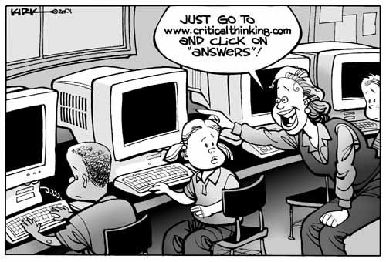
WHY DO WE NEED TO THINK CRITICALLY
In the 21st century with all the amazing
technology ?
Let’s think critically and decide together !

Slide 7
William Perry’s Scheme of Intellectual and Ethical Development
DUALISM:
“There are [always] right and wrong answers…”
MULTIPLICITY
“There are conflicting answers, or maybe no answers;
therefore, one opinion is as good as another, and
EVERYONE HAS THE RIGHT TO THEIR OPINION”
RELATIVISM
“It all depends, so we must learn to evaluate
solutions.”

Slide 8
Critical Thinking Framework ORID
Objective Level What do you see?
_ Facts
Reflective Level What do you feel?
_ Relevance
Interpretive Level What it tells and else is needed?
_ Identification
Decisional Level What can we do?
_ Action

Slide 9
BARRIERS TO
CRITICAL THINKING
THE BIG 5 TO OVERCOME
an over-reliance / absolute acceptance
narrow-mindedness or close-mindedness
lack of relevant background information or ignorance
peer pressure
fear of change or an unwillingness to change

Slide 10
MY Deepest Fear
My deepest fear is not that I am inadequate.
My deepest fear is that I am powerful beyond measure.
It is my light, not my darkness that most frightens me.
I ask myself, who am I to be brilliant, gorgeous, talented and fabulous?
Actually, who am I not to be?
My playing small does not serve the world.
There's nothing enlightened about shrinking so that other people won't feel insecure around me.
I was born to make manifest the glory of life that is within me.
It's not just in some of us; it's in everyone.
And as I let my own light shine,
I unconsciously give other people permission to do the same.
As I am liberated from my own fear, my presence automatically liberates others.
Adapted from “Our Deepest Fear” by Marianne Williamson

