Slide 1
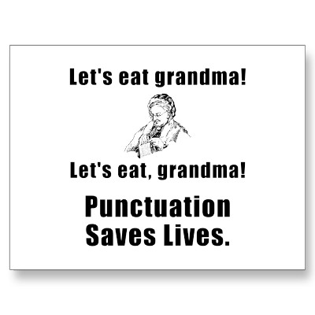
PUNCTUATION by K.Yegoryan

Slide 2
LET’S LOOK AT
THE PUNCTUATION MARKS

Slide 3
WHY WE NEED PUNCTUATION?
Punctuation marks are used as signals to the reader.
When we speak we can pause or change our tone of voice.
In writing we need to signal our reader how we want them to read our writing. If we did not have punctuation, our writing would be one long stream of thought.

Slide 4
EXCLAMATION MARK : IS USED TO SHOW EXCITEMENT OR SURPRISE EX. THIS IS THE BEST SOLUTION!

Slide 5
PERIOD: Use a period at the end of a sentence. We took the dog for a walk. Don’t use a period if the last word in the sentence ends in a period. My mother is an M.D. She’s taking English, math, etc.

Slide 6
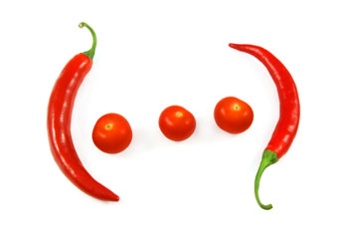
ELLIPSIS
Use ellipsis to indicate words that are being left out:
In the middle of the sentence- just “…”
At the end of the quoted sentence- before the “.”
In between the quoted sentences- after the “.” of preceding sent.

Slide 7
QUESTION MARK:
Use a question mark at the end of a direct question.
EX: Where are you going?
Use a question mark when the sentence is half
question, half statement.
EX: You would like to go, wouldn’t you?
REMEMBER:
Do not use a question mark with an indirect question.
I asked if he would go with me.

Slide 8
QUOTATION
Quotation marks are used for several different purposes, including:
1) Direct Quotations
2) Writing Dialogue
3) Titles or minor works or parts of a whole
Individual words or Phrases
and PARENTHESES

Slide 9
COMMA
Use to:
1. Separate two unrelated adjectives
(when and can be used)
2. After the name or title when directly addressed
(Mr. Smith, here it is)
3. To separate a series of words or phrases
( A, B, and C)
4. To separate two independent sentences
( before the FANBOYS)
5. After the Greeting and Closing words in the letter
( Dear Tom, Sincerely, your coworker Mike)
6. To separate Tag from the Direct Quote
( Tom said, “ Let’s go!”)

Slide 10
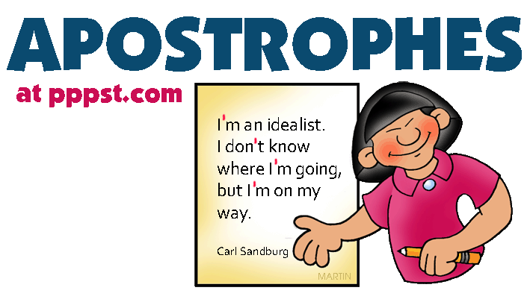
USE :
1) To Form Possessives of
Noun ( the boy’s hat)
2) In contractions
(I am = I’m)

Slide 11
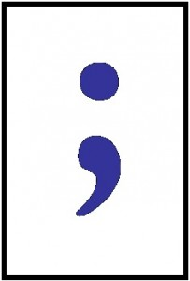
SEMICOLON
To join related independent clauses with no connecting word
Ex: Tom was not feeling good; he had caught cold.
To join two independent clauses with conjunctive adverbs
(however, moreover, therefore, thus, etc.)
Ex: Tom had a headache; therefore, he refused to
come to movies.
To separate items in a series if the items already include commas
Ex: Last summer we went to Rome, Italy; Moscow,
Russia; and Paris, France.

Slide 12
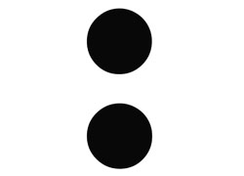
COLON
Use To:
Introduce a list of items
Ex: We have three tutoring centers: The Writing Center, The Learning Center, and The E.O.P.S Tutoring
Following the salutation of a business Letter
Ex: Dear Mr. Smith:
Between the hour and minutes, chapter and verse in Biblical reference
Ex: 1:38 Genesis 1:12
Before starting a quote that is more than 4 lines.

Slide 13
DASH / HYPHEN
USE Dash:
To emphasize a point or
set off an explanatory comment
( like parenthesis)
USE Hyphen to:
1. Combine 2words as a single adjective BEFORE noun
Ex: One-way street BUT NOT The street was one way.
2. Separate a word at the end of a line when hand writing
(between syllables) Ex: pref-er-ence

Slide 14
NOW LET’S PRACTICE
REMEMBER!
Punctuation marks are used as
signals to the reader.
And
Can Save Lives as in Grandma’s Example!
Let’s Read about “Wonder Child” and Punctuate!

