Slide 1
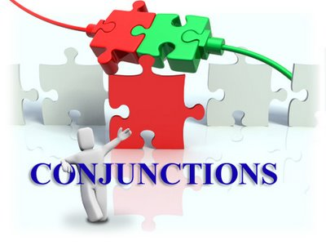
WORKSHOP
BY: Kristina Yegoryan

Slide 2
A conjunction is a part of speech. It is joiner, a word that connects (conjoins) parts of a sentence.

Slide 3
THE TYPES OF CONJUNCTIONS
COORDINATING
SUBORDINATING
CORELLATING
ADVERBIAL

Slide 4
THE TYPES OF CONJUNCTIONS
COORDINATING

