Slide 1
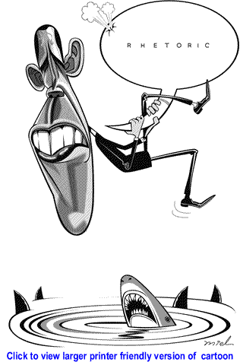
RHETORIC
By: K. Yegoryan

Slide 2
WHAT IS RHETORIC?
“ Rhetoric is the art of ruling the minds of men” ( Plato 428BC-348BC)
“Rhetoric is the art of discovering all
available means of persuasion” (Aristotle)
“Rhetoric is a union of wisdom and
eloquence” (Cincero)
“Ideal rhetoric is the good man speaking well” (Quintilian)

Slide 3
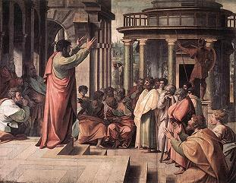
ORIGINS of Rhetoric
Developed in Greece 4th century BC as a teachable discourse of persuasion.
Used as a form of speech instructing listeners.
Classical rhetoric- oratory devoted to political and legal purposes to accuse or justify, as well as speech on occasional ceremony

Slide 4
FATHERS OF RHETORIC
Sophists –teaching art of oratory and virtue of wisdom through paradoxical questions
Isocrates- was against sophists, “rhetoric-true discipline of the soul.” Fitness for occasion-KAIROS”
Plato- Rhetoric -appeal to achieve “Absolute Truth” through philosophy.
Aristotle- Rhetoric is for decision making
Ethos, Pathos, Logos
Aristotle’s SYLLOGISM
Syllogism: (A is B. B is C. Therefore A is C)

Slide 5
ROME
Cincero- 5 cannons of rhetoric (speech making)-Invention, Arrangement. Delivery, Style, Memory
(Today’s 5 P academic essay structure)
Quintilian- revision and imitation approach
(Today's Writing Process and importance of revision)

Slide 6
HISTORY OF RHETORIC
Medieval to Enlightenment- Rhetoric as art of letter writing
16th century- Rhetoric in academia. The influential figure in the rebirth of rhetoric was Erasmus His work was published for 150 editions through Europe and became a school text.
17th century- England: several writers interested in rhetoric. The main focus was on style. Rhetoric was taught in Harvard.

Slide 7
HISTORY OF RHETORIC
18th century- Rhetoric as an argumentative writing style. The most influential school is Scottish Belletristic. Rhetoric was exemplified by such professors as Hugh Blair
Modern Times- Rhetoric integrated into academic institutions. Rise of ads, photography, and media brought forth the new term “ Visual Rhetoric”

Slide 8
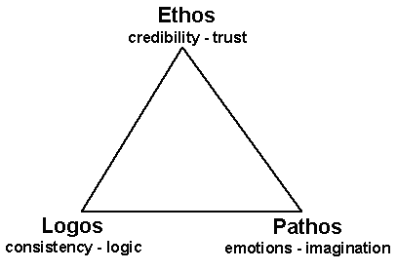
RHETORIC AND ACADEMIC WRITING
Argumentative/Persuasive academic writing is developed upon the rhetorical appeals of
ETHOS- Credibility of the writer
trustworthiness, authority, language
PATHOS- Engaging audiences’ emotions
theme, visuals, stories, delivery
LOGOS- Logical argument, reasonable for audience
facts, shared wisdom, examples,
definition, word choice, similarity

Slide 9
WHAT DO YOU
KNOW ABOUT
RHETORIC?

