Slide 1
Research Tips: Website Evaluation
By:
Colette & Davit

Slide 2
Step 1: Beginning a Research Paper
Be clear on the type of paper your going to write before you begin to research.
Argumentative
Analytical
Exemplification/Informative

Slide 3
Types of Research Papers
Argumentative
Persuasive
Proves a point you want to make
Example Argumentative Research Thesis:
Although it has been proven that
cigarette smoking may lead to health problems in
the smoker, the social acceptance of smoking in public places
demonstrates that many still do not consider secondhand
smoke as dangerous to one's health as firsthand smoke.

Slide 4
Types of Research Papers
Analytical
Starts with a question
Finds an element to analyze throughout a work
Example Analytical Research Thesis:
Though Beowulf is often read as a poem that recounts the heroism and supernatural exploits of the protagonist Beowulf, it may also be read as a poem that served as an example of opposition for tenth-and eleventh-century religious communities found in Danish conquered England.
Notes:
The analytical research paper often begins with the student asking a question (a.k.a. a research question) on which he has taken no stance. Such a paper is often an exercise in exploration and evaluation.

Slide 5
Types of Research Papers
Exemplification:
Presents information without opinion or bias
Gives examples that illustrate information
Example thesis:
Exercising daily is important to keeping a fit body, a focused mind, and a strong heart.
Notes:
For example, perhaps one is interested in the old English poem Beowulf. He has read the poem intently and desires to offer a fresh reading of the poem to the academic community. His question may be as follows:

Slide 6
Step 2: Developing a topic
Brain storm based on assignment
Make sure you can find lots of information on your topic
If necessary, modify topic to fit available research. If there is not much info on your topic it can be difficult to write your paper.

Slide 7
How to do Research
Data needs to be collected from various sources.
the LAVC library has many resources, many are even available on-line, like the LAVC library databases.

Slide 8
Library databases
Access it from the home page:
www.lavc.edu
Direct link:
http://www.lavc.edu/Library/electronicinfo.html
The databases:
Contain information from published works.
Magazine and newspaper articles, encyclopedias
are searchable by Keywords, Subject, Author, Date, etc.
provide citation information.
are paid for by your tuition fees

Slide 9
Library Data Base vs. Websites
Library databases | Web sites
Library databases get their information from professionals or experts in the field. | Web sites can be written by anyone regardless of expertise.
Library databases contain published works where facts are checked. | Web site content is not necessarily checked by an expert.
Library databases are easy to cite in a bibliography and may create the citation for you. | Web sites often don’t provide the information necessary to create a complete citation.
Library databases can help you narrow your topic or suggest related subjects. | Web sites often aren’t organized to support student research needs.
Library databases are updated frequently and include the date of publication. | Web sites may not indicate when a page is updated.

Slide 10
Google Scholar
Similar to the library databases, Google Scholar is an online, free search engine that searches a wide variety of sources, including academic publishers, universities, and Peer-reviewed articles.
http://scholar.google.com/

Slide 11
Researching on your own
If you are not using a search engine that filters results for you like Google Scholar or the LAVC databases, you need to be able to evaluate websites on your own.

Slide 12
Researching on your own
How to evaluate Websites
Authorship, Currency, and Accuracy
For example, check the bottom of the page
-how old is it?
-Does it list who the author is?
http://zapatopi.net/afdb/
(this site was last updated in 2008)

Slide 13
Researching on your own
Check the Website Domain
-.gov and .edu are safest
https://owl.english.purdue.edu/
– Websites from well known newspapers or magazines are usually safe.
examples:
-Los Angeles Times www.latimes.com
-Forbes
-Wall Street Journal

Slide 14
Researching on your own
Purpose and content
-Is the information biased?
http://www.martinlutherking.org/
Is it legitimate research or a joke?
http://www.theonion.com/
If you are not sure if the information is real search Google https://www.google.com/webhp?source=search_app#q=the+onion
(Here the Wikipedia tells you that
it is a joke site)

Slide 15
Researching on your own
Functionality, and Design
-do the links work?
-does it look nice or cheap?
-is it well organized?
http://burmesemountaindog.info/
This isn’t even spelled correctly its “Bernese” mountain dog

Slide 16
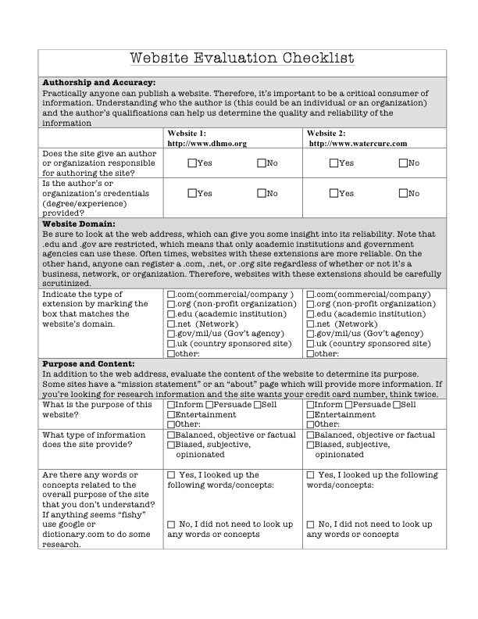
Exercise

Slide 17
Exercise
Use the checklist to evaluate these two websites. Decide which one is real and which one is fake.
www.dhmo.org
www.watercure.com

Slide 18
Step 3:
Outline your paper
Organize your research based on this outline
what quotes will you use?
Why? Do they help your point?
Notes:
Choose a topic: The research paper topic must be unique. Pick a topic that interests or challenges you.
Find information: Surf the Net. Make use of search engines as well as other research tools as a starting point. Check out useful URLs, general and background information online.
State your Thesis: your thesis statement will be like your belief declaration. The main portion will consist of arguments to support as well as defend your belief.
Get some Help: if it is your first research, make sure to consult an experienced friend. Beginner’s mistake in research usually leads to a waste of time and resources.
Know your research: Know WHAT you have to study, WHY you have to study it, and HOW the results will contribute to the pool of knowledge for the topic.
Organize your notes: organize all the info and analyze your research data critically. Note some opposing views if they help to support your research.
Revise Draft and Outline: check everything for any content errors. Double check the facts and organize the outline if needed.
Type the final paper: proofread final paper cautiously for any possible errors. Reread your paper and make sure you understand fully what is expected of you.

Slide 19
Make sure not to Plagiarize
Notes:
Make sure not to plagiarize website

Slide 20
Plagiarism
Submitting someone else’s texts as one’s own or attempting to blur the line between one’s own ideas or words and those borrowed from another source.
Carelessly or inadequately citing ideas and words borrowed from another source.
Notes:
Research-based writing in American institutions, both educational and corporate, is filled with rules that writers, particularly beginners, aren't aware of or don't know how to follow. Many of these rules have to do with research and proper citation. Gaining familiarity with these rules, however, is critically important, as inadvertent mistakes can lead to charges of plagiarism, which is the unaccredited use (both intentional and unintentional) of somebody else's words or ideas.

Slide 21
Exercise
Watch the video:
http://ed.ted.com/lessons/the-punishable-perils-of-plagiarism-melissa-huseman-d-annunzio
Take Plagiarism Quiz

Slide 22
How Not to Plagiarize:
Avoid accusations of plagiarism by properly citing sources
MLA
APA
Chicago Manual of Style
Notes:
MLA is the most commonly used in Academics, so we are just covering MLA.

Slide 23
_{Basic Features of MLA Citation}
In text citation:
“O Romeo, O Romeo, wherefore art thou Romeo?” (Romeo and Juliet 2.2.36).
Page at the end of the document:
Works cited
Shakespeare, William. Selected plays. English Press: London. 23 March 2013. print.
Kind of like this…

Slide 24
Works Cited
Genre and The Research Paper. Owl.english.purdue.edu. Jack Raymond Baker, Allen Brizze. 30 March 2011. Web. 14 October 2013.
Overview and Contradictions. Owl.english.purdue.edu. Karl Stolley, Allen Brizze, Joshua M. Paiz. 6 June 2013. Web. 14 October 2013.
What is Research? Personal.psu.edu. N.p., n.d.. Web. 14 October 2013.

Slide 25
Thank you!

