Slide 1
Thesis Statements

Slide 2
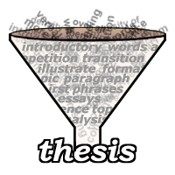
A thesis statement is…
A sentence that goes at the end of your introductory paragraph. IT IS THE LAST SENTENCE OF INTRODUCTION
The main idea of the whole essay.
A debatable statement, the author’s argument /opinion.
It is usually 1 sentence or 2 max.

Slide 3
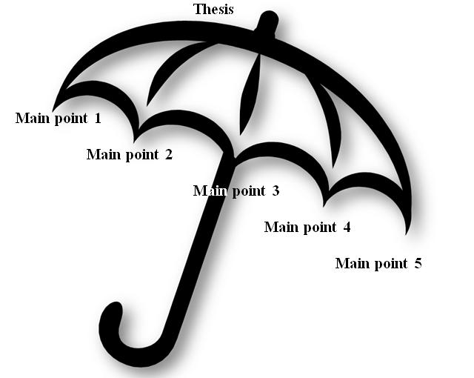
What does a thesis statement do?
A thesis statement…
provides the point you (the authors) want to prove.
presents your argument in a concise form.
can provide the opposite point of view.
gives the structure your essay will follow; it is
like a roadmap that tells what to expect next.
Thesis is also said to be like an umbrella that covers all the main ideas of the essay.

Slide 4
Are there different types of thesis statements?
YES
Open vs. Complete
An Open Thesis does not contain the body points.
i.e. Everyone should drive a hybrid car.
A Complete Thesis includes the body points.
i.e. Everyone should drive a hybrid car because they pollute less, they get better mileage, and they help reduce gasoline costs.

Slide 5
Your thesis is the foundation of your essay
The entire essay attempts to prove that your thesis is correct.
Constantly refer back to your thesis to make sure that your essay is staying on track
If you used a Complete Thesis, each of your body paragraphs should cover one of the points mentioned in your thesis.
Your body paragraphs should go in the same order as the points they cover were mentioned in the thesis.

Slide 6
ESSAY AND THESIS
The word “essay” means “to try.” The term was first used during the Renaissance ( 16th century) by Michel Montaigne
An essay is a piece of writing which is often written from an author's personal point of view.
THE MAIN ESSAY TYPES ARE:
Narrative ( to tell a story/incident)
Expository (to explain or acquaint with something)
Exemplification (brings in many examples to support a choice/argument)
Cause and Effect
Descriptive
Definition
Compare and Contrast
Persuasive/ Argumentative (prove a point)

Slide 7
Thesis statements depend on essay types
Narrative- Gives a one-sentence summary of a narrative essay.
Expressive- Expresses a personal feeling about the topic.
Informative- Gives an overview of the information in the essay.
Argumentative- Argues a specific, debatable point.
Exploratory- Makes a point, but does not argue that it is true.

Slide 8
The ESSAY HAS A SPECIFIC STRUCTURE
INTRODUCTION
Thesis
BODY Paragraphs
A Main topic 1
B Main topic 2
C Main Topic 3
CONCLUSION
Restatement of Thesis

Slide 9
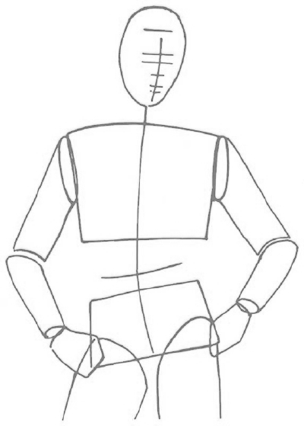
ESSAY
STRUCTURE
K’s ESSAY MAN
INTRODUCTION
THESIS (Argument + A, B, and C supports)
A
BODY
B
C
CONCLUSION

Slide 10
PARTS OF ESSAY
Introduction: The introductory paragraph sets the tone and the direction for the composition. The paragraph starts with a general statement or question that captures the reader’s attention. The paragraph concludes with a specific thesis statement.
Body: The body of a composition can consist of any number of paragraphs that support the thesis statement. Typically compositions contain one to three body paragraphs. Each body paragraph has its own topic sentence with supporting evidence or commentary.
Conclusion: The concluding paragraph brings the composition to a close. It often begins with a restatement of the thesis in different words. The paragraph ends with a more general statement or a call to action.

Slide 11
Have you ever had an interest in self defense? Karate is martial art and a way of fighting and self-defense based on an understanding of both body and mind. As a college student, I discovered tae kwon do. Even though I was physically fit and planned to become a police officer, I thought that women needed special skills to protect themselves. Karate teaches these skills and more. The person who practices karate gains discipline, maturity, and a changed self-concept.
First, the discipline of karate helps the student to outfight and outsmart her opponent. For a while, I didn’t appreciate the discipline. We had to practice every night in class and also commit to a rigid exercise plan outside of class. We also had to be disciplined in our study of the course materials.
Second, with practice, karate increases maturity. Although maturity sometimes comes with age, it can also come with experience. Maturity is something that I thought I had developed until I started my karate classes, and I realized that I have a hot temper and often jump to conclusions.
Finally, after a year or so, karate can change the student’s self-concept. This happened to me. On one hand, I became confident that I had the skills to take care of business if necessary. On the other hand, the better I got, the more I started to act like a pussycat instead of a lion. Inside I knew that I had nothing to prove to anybody.
As I discovered firsthand, the practice of karate can bring personal benefits that go far beyond self-defense. I know that my own maturity, discipline, and sense of self have been enhanced through my involvement in this martial art. Imagine the benefits that practicing karate could possibly bring to your own life. Chances are that there classes are being offered in your local community right now. What are you waiting for? Sign-up today.
Adapted from the following book:
Fawcett, Susan and Alvin Sandberg. Grassroots with Readings. New York: Houghton Mifflin, 1998. Print.

Slide 12
THESIS STATEMEMT
It is the main idea of the whole essay
It conveys the argument of the writer and introduces the support (s) that are later developed in the Body paragraph.
Ex: The person who practices karate gains discipline, maturity, and a changed self-concept.

Slide 13
What does a strong thesis statement look like?
Remember that a strong thesis statement makes a definite point.
That point should be your own opinion.

Slide 14
A Few Examples
WEAK
The Adventures of Tom Sawyer was written by Mark Twain in 1876.
Some people think that The Adventures of Tom Sawyer is Mark Twain’s best novel.
WEAK
STRONG
The Adventures of Tom Sawyer is Mark Twain’s best novel.
The Adventures of Tom Sawyer is Mark Twain’s best novel because of its use of satire, imagery, and symbolism.
STRONGER

Slide 15
An introductory paragraph with a weak thesis
Vague
Many people believe that Dominican Republic is a wonderful vacation spot. It offers great beaches with beautiful sands and lots of attractive activities for people of all ages. That’s why people from all over the world make this part of the world their favorite vacation spot. My opinion of it is not quite the same.
Weak

Slide 16
A Simple Thesis Formula
Although counter argument, actually your argument because 1st supporting idea, 2nd supporting Idea, and 3rd supporting idea.

Slide 17
Try it! Prompts
What are three things about Los Angeles Valley College you believe should be changed? Why?
What do you believe are the benefits of daily exercise?
Are online courses better than traditional course? Why or why not?
Do you believe that television has more of a negative or positive impact on society? Why or why not?
What age do you think is more appropriate for someone to be able to get their driver’s license, and why?
What do you think should be the main priorities for California’s budget?

Slide 18
Try it!
With your group, discuss the topic you have been given. Then on your own, write a Complete Thesis based on the prompt.

Slide 19
Thanks for attending!
Let’s Watch this video and think of 3 secrets of success.
Then try to create a clear, strong COMPLETE Thesis Statement:
http://www.ted.com/talks/richard_st_john_success_is_a_continuous_journey.html

